Slide 1
Power Management in Smart Homes - Power Usage Analytics -
IOT Analytics

Slide 2
Energea’s goal
Grow the business in the smart home market
How will IOT Analytics contribute to achieving this goal?
Insight into the data
Initial recommendations
Data management

Slide 3
Households - final customer perspective
Energy and money savings
Billed for actual power consumption
Detailed information enables monitoring and control over household power consumption

Slide 4
Energea’s perspective
Improving the customer experience to manage power consumption
Achievable through sub-metering devices as a solution allowing measurement of individual unit consumption

Slide 5
IOT Analytics’ role
Support through power usage analytics
Develop analytics for a new set of electrical sub-metering devices used for power management in smart homes

Slide 6
Power usage analytics
Analytics of metered data includes: highlighting spikes, anomalies in usage pattern, growth or drop in energy consumption, changes in key impacting parameters etc.
Prediction of energy consumption
Creating energy models of buildings

Slide 7
Source of data
Dataset containing 47 months (December 2006 – November 2010) of energy usage data from three sub-metering devices including 2075259 measurements
Data is stored on a MySQL database in several annual tables

Slide 8
Initial data exploration
Early data preprocessing and exploration disclose trends and permits to identify certain recommendations
Annual as well as total power usage statistics
Change in power usage between 2006 and 2009 within the same sub-metering devices

Slide 9
Initial data review
 | 2009 power usage | Change between 2006-2009 | Min and max (watt-hours)
Sub-meter # 1 (kitchen) | 12 % | - 8 % | 1 - 82
Sub-meter # 2 (laundry room, light) | 12 % | - 31% | 1 - 78
Sub-meter # 3 (AC, water heater) | 75 % | + 18% | 1 - 31

Slide 10
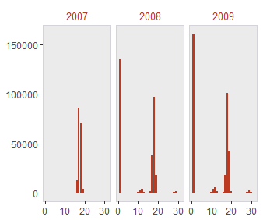
Submeter # 3: power measurements (in watt-hours)

Slide 11
Recommendations
More precise analysis requires improvements in further data collection
Data regarding sub-meter # 3 should be divided into two categories: water-heater and AC, as two most energy consuming appliances
Additional information about AC temperature setting point
Information about local weather conditions

Slide 12
Data management & security
Data management plan addressing data security challenges.
Overall architecture maintaining security at all levels - from the database and storage system to the network, computing and other supporting tools.
Security access control including establishing „least privilege” access

Slide 13
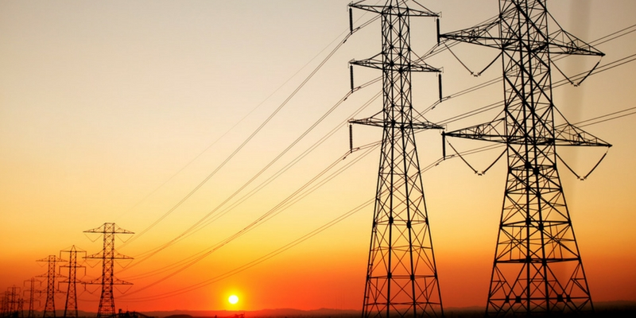
IOT Analytics

